Slide 1
Info-6079 Security Application
Subprocess - Emails

Slide 2
Lecture preview
subprocess module
Sending emails through python
Notes:
from platform import python_implementation, python_version_tuple
print(python_implementation())
for atr in python_version_tuple():
print(atr)
https://docs.python.org/3/py-modindex.html.

Slide 3
Subprocess Module
Notes:
Links:
http://queirozf.com/entries/python-3-subprocess-examples#call-example
https://docs.python.org/3/library/subprocess.html
https://python-forum.io/Thread-Ping-command-using-python-3-6-5

Slide 4
Subprocess
Subprocess provides the ability to
spawn new processes,
connect to their input/output/error pipes,
and obtain their return codes.
Subprocess intends to replace module / functions os.system and os.spawn.

Slide 5
Subprocess
A recommended approach to invoke subprocesses:
Python 3.5 and later use: use run()
Python 2.7 through 3.4 use: call()
Subprocesses.run() is safer function.
Should use when ever possible.
Returns CompletedProcess object if it was successful
By default, does not raise an exception if the underlying process errors
Notes:
In Python 3.5 and higher you could use call() function but it is not recommended. It less safe than run().
Should use call function when you don’t have an option.

Slide 6
Subprocess.run()
Needs to have command as an argument, this could be a single string or a list of strings. It is always the first thing entered in the function.
Ex:
subprocess.run(["ping", "fanshawec.ca"])
subprocess.run(["ping", "fanshawec.ca", "-n", "10"])
subprocess.run(['IPCONFIG’])
subprocess.run(['NETSTAT'])

Slide 7
Subprocess.run() parameters include:
Stdout , Stderr, and capture_output allow you to capture output
Stdout = subprocess.PIP
subprocess.PIPE: indicates that standard stream should be opened
shell=True, makes the command string to be interpreted as a raw shell command
universal_newlines: when set to true the output is in text stream and not byte stream

Slide 8
subprocess.run()
stdout = None or not having a stdout, will print to the console (to screen)
Same thing with stderr, which deals with errors
subprocess.run(["ping", "fanshawec.ca"])
Pinging fanshawec.ca [52.60.137.41] with 32 bytes of data:
Reply from 52.60.137.41: bytes=32 time=28ms TTL=49
Reply from 52.60.137.41: bytes=32 time=23ms TTL=49
Reply from 52.60.137.41: bytes=32 time=22ms TTL=49
Reply from 52.60.137.41: bytes=32 time=30ms TTL=49
Ping statistics for 52.60.137.41:
Packets: Sent = 4, Received = 4, Lost = 0 (0% loss),
Approximate round trip times in milli-seconds:
Minimum = 22ms, Maximum = 30ms, Average = 25ms

Slide 9
2nd ways to output Subprocess.run() results:
Does not output straight to screen
Using stdout=subprocess.PIPE and save to a CompletedProcess variable
Example:
p = subprocess.run(["ping", "fanshawec.ca"], stdout=subprocess.PIPE)
When you want to out put you could use: print(out.stdout.decode()) or print(out.stdout)

Slide 10
Output:
output using stdout.decode
Pinging fanshawec.ca [52.60.137.41] with 32 bytes of data:
Reply from 52.60.137.41: bytes=32 time=25ms TTL=49
Reply from 52.60.137.41: bytes=32 time=22ms TTL=49
Reply from 52.60.137.41: bytes=32 time=30ms TTL=49
Reply from 52.60.137.41: bytes=32 time=23ms TTL=49
Ping statistics for 52.60.137.41:
Packets: Sent = 4, Received = 4, Lost = 0 (0% loss),
Approximate round trip times in milli-seconds:
Minimum = 22ms, Maximum = 30ms, Average = 25ms
output using stdout
b'\r\nPinging fanshawec.ca [52.60.137.41] with 32 bytes of data:\r\nReply from 52.60.137.41: bytes=32 time=25ms TTL=49\r\nReply from 52.60.137.41: bytes=32 time=22ms TTL=49\r\nReply from 52.60.137.41: bytes=32 time=30ms TTL=49\r\nReply from 52.60.137.41: bytes=32 time=23ms TTL=49\r\n\r\nPing statistics for 52.60.137.41:\r\n Packets: Sent = 4, Received = 4, Lost = 0 (0% loss),\r\nApproximate round trip times in milli-seconds:\r\n Minimum = 22ms, Maximum = 30ms, Average = 25ms\r\n'
Notes:
When running code in Wing IDLE there will be spaces between the lines in out.stdout.decode().
To get this output, ran code through CMD terminal.
Make sure the variable out matches the variable used
print("output to a variable p")
pOutput = subprocess.run(["ping", "fanshawec.ca"], stdout=subprocess.PIPE)
print("output using stdout.decode")
print(pOutput.stdout.decode())
print("\noutput using stdout")
print(pOutput.stdout)

Slide 11
Don’t want to write decode()
Add universal_newlines=True as an option in run function
p = subprocess.run(["ping", "fanshawec.ca"], stdout=subprocess.PIPE, universal_newlines=True)
Notes:
Universal newline support can be disabled during configure because it does have a small performance penalty, and moreover the implementation has not been tested on all conceivable platforms yet.
It might also be silly on some platforms (WinCE or Palm devices, for instance).
If universal newline support is not enabled then file objects do not have the newlines attribute, so testing whether the current Python has it can be done with a simple:
if hasattr(open, 'newlines’):
print 'We have universal newline support’
On its way OUT
The logic behind this is fairly simple. It's considered more "Pythonic" to have named things rather than unnamed things. So you use a named parameter rather than a character flag. The flag idea is very much a leftover of Python's C implementation and it's small wonder that it's being weeded out.

Slide 12
3rd ways to output Subprocess.run() results:
Could set to a file object as we learned in lesson 7
Example:
with open(‘out.txt’,’w+’) as fout:
subprocess.run (["ping", "fanshawec.ca"], stdout=fout)
This will allow you to save the information gathered and/or send it

Slide 13
What information can we get?

Slide 14
Ping
subprocess.run(["ping", "fanshawec.ca"])
subprocess.run(["ping", "fanshawec.ca", "-n", "10"])
subprocess.run(["ping", "8.8.8.8"])

Slide 15
dir
subprocess.run(["dir"], shell=True)
subprocess.run(["dir", "c:\\"], shell=True)

Slide 16
output DIR
output DIR
Volume in drive D is NTFS_Fanshawe
Volume Serial Number is 2E20-95BC
Directory of D:\2020_ACTIVE_COURSES\INFO_6079_W2020\Week12
04/05/2020 10:39 AM <DIR> .
04/05/2020 10:39 AM <DIR> ..
04/05/2020 10:36 AM 3,025,023 Lesson 13 - Info 6079 Security Application.pptx
04/05/2020 10:40 AM 465 logFile.txt
04/05/2020 11:05 AM 878 week12_code.py
3 File(s) 3,026,366 bytes
2 Dir(s) 56,374,009,856 bytes free
Volume in drive D is NTFS_Fanshawe
Volume Serial Number is 2E20-95BC
Directory of D:\2020_ACTIVE_COURSES\INFO_6079_W2020\Week12
04/05/2020 10:39 AM <DIR> .
04/05/2020 10:39 AM <DIR> ..
04/05/2020 10:36 AM 3,025,023 Lesson 13 - Info 6079 Security Application.pptx
04/05/2020 10:40 AM 465 logFile.txt
04/05/2020 11:05 AM 878 week12_code.py
3 File(s) 3,026,366 bytes
2 Dir(s) 56,374,009,856 bytes free

Slide 17
output DIR C:\
output DIR
Volume in drive D is NTFS_Fanshawe
Volume Serial Number is 2E20-95BC
Directory of D:\2020_ACTIVE_COURSES\INFO_6079_W2020\Week12
04/05/2020 10:39 AM <DIR> .
04/05/2020 10:39 AM <DIR> ..
04/05/2020 10:36 AM 3,025,023 Lesson 13 - Info 6079 Security Application.pptx
04/05/2020 10:40 AM 465 logFile.txt
04/05/2020 11:05 AM 878 week12_code.py
3 File(s) 3,026,366 bytes
2 Dir(s) 56,374,009,856 bytes free
Directory of c:\
11/13/2019 01:47 PM <DIR> abcltd
08/26/2019 09:02 PM <DIR> ADP
12/09/2019 09:49 AM <DIR> AS
05/30/2019 03:13 PM <DIR> BBFSI
11/20/2019 11:35 PM <DIR> Beat_Buddy
11/28/2019 02:31 PM <DIR> carswell_data
10/15/2018 09:17 AM <DIR> eSupport
01/12/2020 05:58 PM <DIR> Fanshawe_2019
02/26/2020 09:22 AM <DIR> Fanshawe_2020
. . . .
1 File(s) 317,071 bytes
46 Dir(s) 327,333,076,992 bytes free

Slide 18
Network Administration: ARP Command
subprocess.run(["arp", "-a"])
Interface: 192.168.0.137 --- 0x1a
Internet Address Physical Address Type
192.168.0.1 f8-e9-03-c1-08-b4 dynamic
192.168.0.105 f8-e9-03-d5-5f-55 dynamic
192.168.0.130 14-4f-8a-f1-05-95 dynamic
192.168.0.255 ff-ff-ff-ff-ff-ff static
224.0.0.22 01-00-5e-00-00-16 static
224.0.0.251 01-00-5e-00-00-fb static
224.0.0.252 01-00-5e-00-00-fc static
239.255.255.250 01-00-5e-7f-ff-fa static
255.255.255.255 ff-ff-ff-ff-ff-ff static
Notes:
Address Resolution Protocol, or ARP
was developed in the early 1980s as a general-purpose address translation protocol for IP networks. Besides Ethernet and Wi-Fi, ARP has been implemented for ATM, Token Ring, and other physical network types.
ARP allows a network to manage connections independently of the specific physical device attached to each one. This enables the internet protocol to work more efficiently than if it had to manage addresses of different kinds of hardware devices and physical networks on its own.
Network Administration: ARP Command
The IP address only gets you across the Internet to the required destination network.
The router on that network must discover the physical address (MAC address) on the network of the destination host. It does this by sending out an ARP broadcast on the network that basically says "what is the MAC address of the host on this network whose IP address is....."?
Only the host with that IP address replies and they send back their MAC address.
The router stores that (in the ARP cache) and can now build the physical network frame with the right destination MAC address.

Slide 19
Network Administration: ARP Command
subprocess.run(["arp", "-a", "192.168.2.1"])
Interface: 192.168.0.137 --- 0x1a
Internet Address Physical Address Type
192.168.0.105 f8-e9-03-d5-5f-55 dynamic
Notes:
Network Administration: ARP Command
Using the arp command allows you to display and modify the Address Resolution Protocol (ARP) cache. An ARP cache is a simple mapping of IP addresses to MAC addresses. Each time a computer’s TCP/IP stack uses ARP to determine the Media Access Control (MAC) address for an IP address, it records the mapping in the ARP cache so that future ARP lookups go faster.
If you use the arp command without any parameters, you get a list of the command’s parameters. To display the ARP cache entry for a specific IP address, use an -a switch followed by the IP address.

Slide 20
Other include:
IPCONFIG
NETSTAT
SYSTEMINFO
nslookup

Slide 21
Windows Commands could be found at:
https://docs.microsoft.com/en-us/windows-server/administration/windows-commands/commands-by-server-role

Slide 22
Sending Emails (smtplib module)
Notes:
Links:
https://automatetheboringstuff.com/2e/chapter18/
https://automatetheboringstuff.com/chapter16/
https://docs.python.org/3/library/smtplib.html

Slide 23
Sending Email via Python
Python does not offer a nice graphical interface like Gmail, outlook, or yahoo.
WE need to call functions to perform SMTP Steps.
We needs to use smtplib module

Slide 24
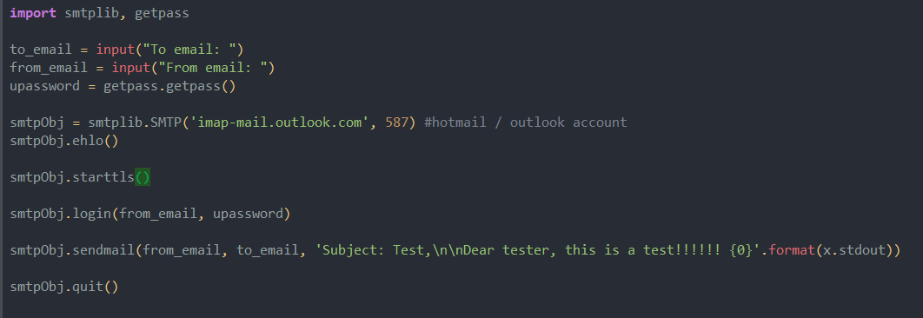
How to use smtplib

Slide 25
Lines explanation
import smtplib, getpass
Imports smtplib and getpass modules
to_email = input("To email: ")
Gets from user email address to sent to
from_email = input("From email: ")
Gets from user email address sent from
upassword = getpass.getpass()
Gets password, you do not see what is typed

Slide 26
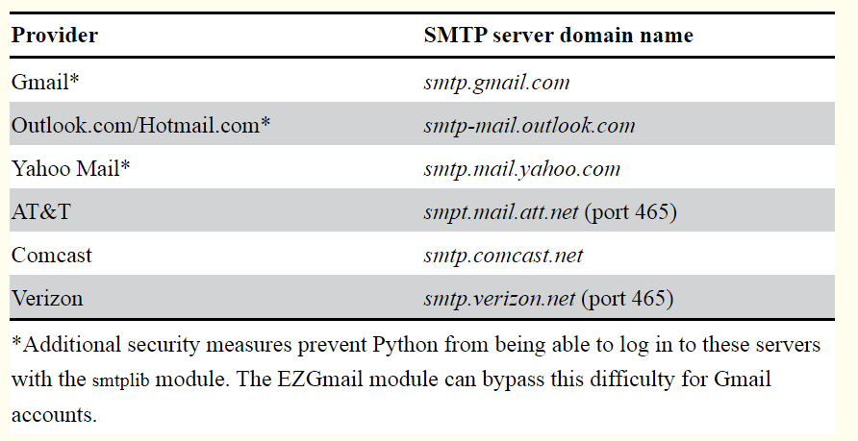
Lines explanation
smtpObj = smtplib.SMTP('imap-mail.outlook.com', 587)
Source: https://automatetheboringstuff.com/2e/chapter18/

Slide 27
Lines explanation
smtpObj.ehlo()
Says hello to the SMTP server, first step of establishing a connection
smtpObj.starttls()
Since we are using TLS Encryption we need to call this function to enable encryption
smtpObj.login(from_email, upassword)
Login information sent to server

Slide 28
Lines explanation
smtpObj.sendmail(from_email, to_email, 'Subject: Test,\n\nDear tester, this is a test!!!!!! {0}'.format(x.stdout))
Method that sends email
sending email address as strings
To email address as string
Email body as string
smtpObj.quit()
Closes the connection

Slide 29
Allowing access to Gmail Less secure app access
https://myaccount.google.com/lesssecureapps?pli=1
It is not recommended to do so.
If you do, only open while you need to and close when done.
Consider user a different account or create a temp account
Notes:
A more secure option would be

Slide 30
Gmail API – ezgmail section source: https://automatetheboringstuff.com/2e/chapter18/
Notes:
Links:
https://automatetheboringstuff.com/2e/chapter18/
https://automatetheboringstuff.com/chapter16/
https://docs.python.org/3/library/smtplib.html

Slide 31
Gmail API - ezgmail
Is more secure than smtplib
Official page is: https://developers.google.com/gmail/api/v1/reference/
To install Ezgmail in your terminal run following:
Windows: pip install --user --upgrade ezgmail
macOS or linux:
pip3 install --user --upgrade ezgmail
-upgrade make sure latest version is installed

Slide 32
Gmail API - ezgmail
Before using ezgmail
Need to Enable gmail API at https://developers.google.com/gmail/api/quickstart/python/
After filling out a form a link to a file with credentials.json, which will need and download a the same folder as your python file (.py)
This will file will contain your client ID and Client secret information, just like a password

Slide 33
In your could we will use:
In an interactive shell, enter the following code:
import ezgmail, os
os.chdir(r'C:\path\to\credentials_json_file’)
Ezgmail.init()
The path in os.chdir needs to be where the credentials_json file is
Ezgmail.init()
Opens the google sign-in page

Slide 34
Code explanation
The path in os.chdir needs to be where the credentials_json file is
Ezgmail.init()
Opens the google sign-in page
You will need to enter your Gmail credentials
May get a warning app is not verified. It is fine
Will get a QuickStart wants access, press allow and close browser
This will create a token.json file with credentials.json.
These files you’ll need for python script to send and read emails with out password in source code

Slide 35
Code in script:
import ezgmail
ezgmail.send('recipient@example.com’,'Subject line', 'Body of the email’)
Send with attachment
ezgmail.send('recipient@example.com', 'Subject line', 'Body of the email', ['attachment1.jpg', 'attachment2.mp3'])

Slide 36
Code in script:
With bcc and cc
ezgmail.send('recipient@example.com', 'Subject line', 'Body of the email', cc='friend@example.com', bcc='otherfriend@example.com,someoneelse@example.com')

